Slide 1

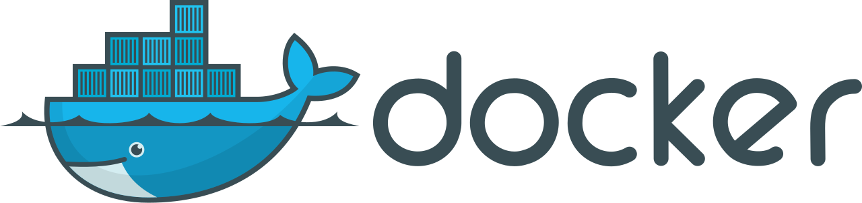
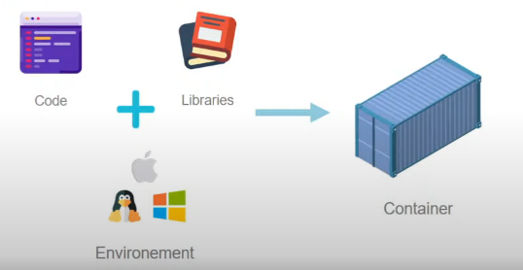
Docker Overview
What is Docker?
Why we need it and what problem it solves?
Features
Advantages

Slide 2
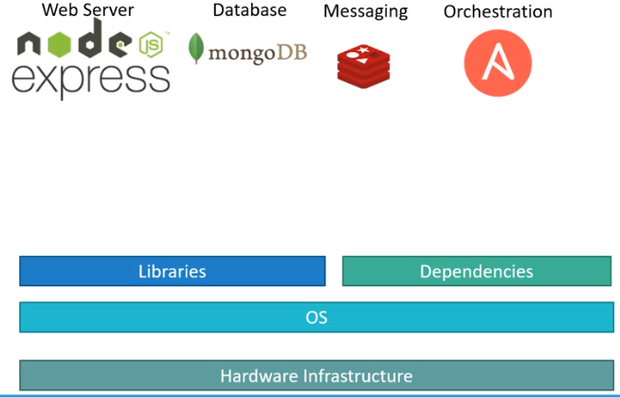
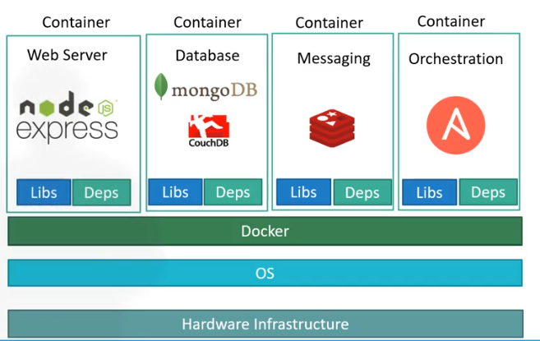
With Out Docker
With Docker

Slide 3
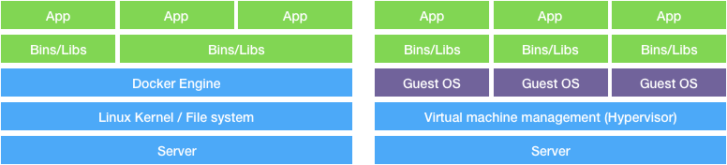
Docker vs Virtual Machines

Slide 4
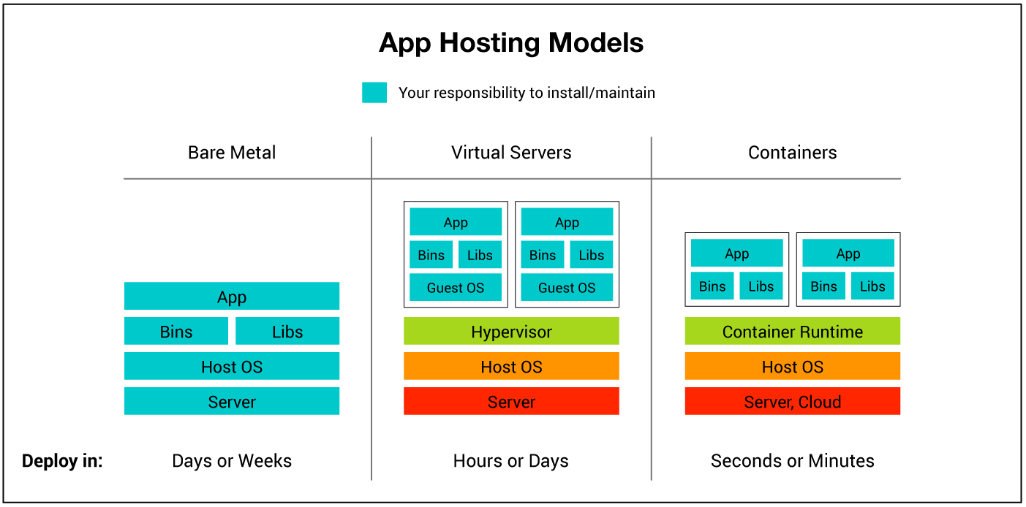

Slide 5
Features and Advantages of Docker
Containerization
Portability
Isolation
Efficiency
Version Control
Scalability and Security
Docker Hub and Docker Compose

Slide 6
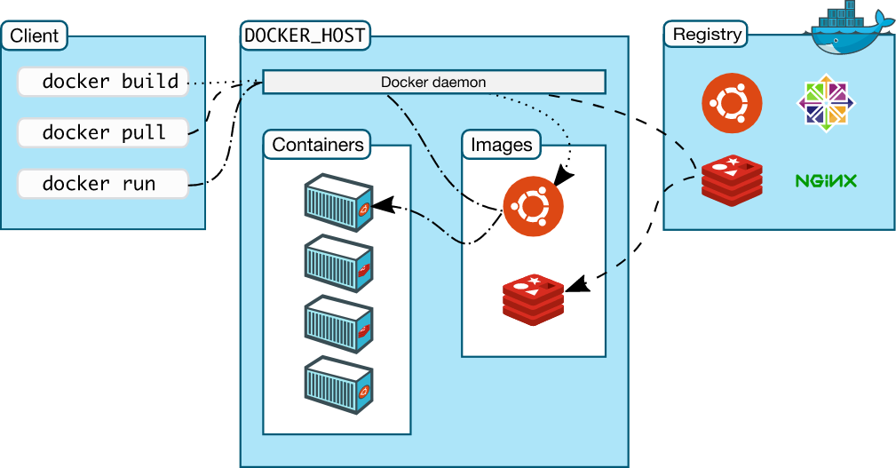
Typical Docker Workflow
Applications are Containerised are readily available on Public Repository, DockerHub.
Once we have right image, we can pull and run the image as a container to run the application. We can run as many applications as we want with deferent versions.
We just need to find the right OS, Tools and Application container images.

Slide 7
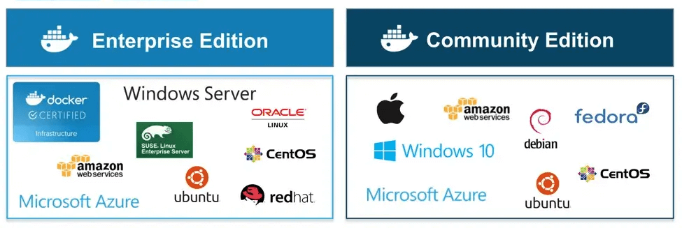
Installing Docker

Slide 8
Basic Docker Commands
$docker pull - pulls the image from dockerhub
$docker run – pull the image and run a container
$docker ps – lists the running containers
$docker ps -a – lists all the containers
$docker stop – stops the container
$docker rm – remove the container
$docker images – lists the docker images
$docker rmi – to remove the image
$docker exec – execute a command on docker
$docker run -d - docker detach mode
$docker attach <id> - Attach to a running docker
$docker cp <local_file_path> <container_id_or_name>:<container_path>
Docker Life Span

Slide 9
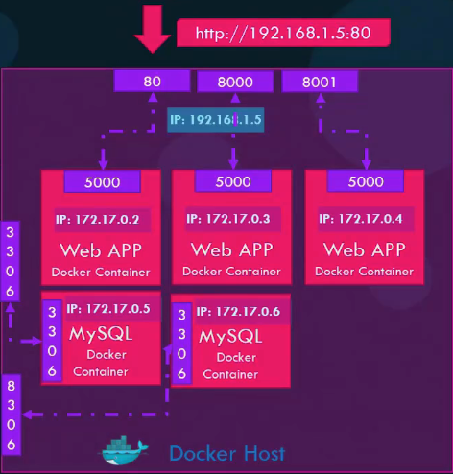
You can use the -p or --publish option with docker run to map a port. For example, if you have a web application running on port 80 inside a container and you want to expose it on port 8080 on your host machine, you can do it like this:
$docker run -p 8080:80 my-container
We can deploy multiple container of the same image and assign to deferent ports on the Docker host.
We can not map multiple container ports to single port on the Host machine.

Slide 10
Docker advanced commands
$docker run <image>:tag [Pull the image with tag]
$docker run -it <image> [Run interactive terminal mode][kodekloud/simple-prompt-docker]
$docker run –it ubuntu bash
$docker run –p 8081:8080 [ Port mapping]
$docker run -v /opt/datadir:/var/lib/mysql mysql [Mapping the data directory in the container to the host machine directory]
$docker inspect <containername/id> [ Complete details about the container]
$docker logs <containername/id> [ will provide the logs when running in detached mode]
$docker run mintlinux cat /etc/*release*
Ex: $socker run ubuntu sleep 1500 [You can not come out. You need to stop the container from another console]
$docker run -p 8081:8080 -v /root/webapps:/usr/local/tomcat/webapps
Ex: Run jenkins container and map data directory and delete jenkins and rebuild.
$docker run –p 8080:8080 -v /root/jenkins:/var/jenkins_home -u root jenkins
$docker history <imagename>
$docker rm $(docker ps -aq) [Removes all the docker images]

Slide 11
Docker Images
We can create our own docker images, if no compatible image is found on Docker Hub.
To create a docker image, we need to write a Dockerfile. From Dockerfile we can build Docker Image.
Steps involved in creating a Dockerfile
Choosing a base image
Setting environment variables
Copying files
Running commands
Exposing ports
Defining entry points

Slide 12
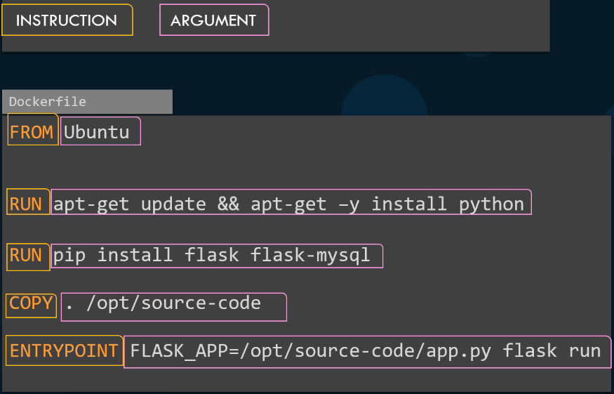
D
O
C
K
E
R
F
I
L
E

Slide 13
FROM ubuntu Layer1: Pull and runs Ubuntu
RUN apt-get install default-jdk Layer2: Install the Packages
RUN mkdir /opt/tomcat/
WORKDIR /opt/tomcat
ADD https://dlcdn.apache.org/tomcat/ Layer3: Download the tomcat Package
tomcat-9/v9.0.54/bin/apache-tomcat-9.0.54.tar.gz /opt/tomcat
RUN tar xvfz apache*.tar.gz
RUN mv apache-tomcat-9.0.54/* /opt/tomcat Layer4: Copying required files
EXPOSE 8080
CMD ["/opt/tomcat/bin/catalina.sh", "run"] Layer5: Exposing the required services
We can check the layer information from docker history command. If docker run fails at a particular step and we run it again, it starts from the failed step.

Slide 14
Command Summery
FROM: To pull the Docker Image
RUN: To execute Commands
CMD: To provide defaults for an executing containers
ENTRYPOINT: To configure a container that will run as an executable
WORKDIR: TO sets the working directory
COPY: To copy a directory from your local machine to the docker container
ADD: To Copy files and folders from your local machine to docker container
EXPOSE: Informs Docker that the container listens on the specified port
ENV: To set environment variables

Slide 15
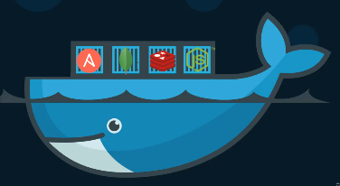
Docker Compose
Docker Compose is a tool for defining and running multi-container Docker applications. With Docker Compose, you can define and manage complex applications that consist of multiple interconnected containers.

Slide 16
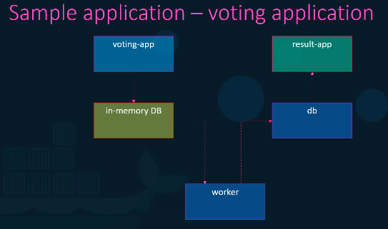
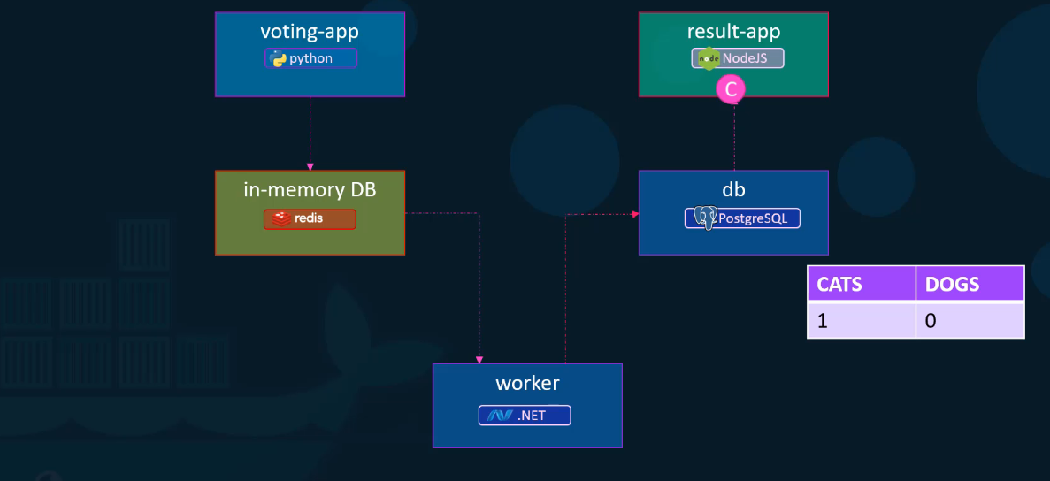

Slide 17
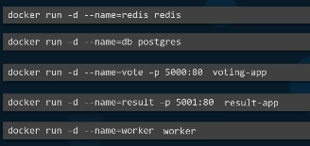
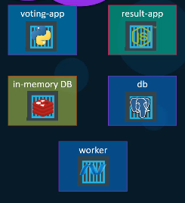
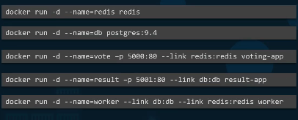

Slide 18
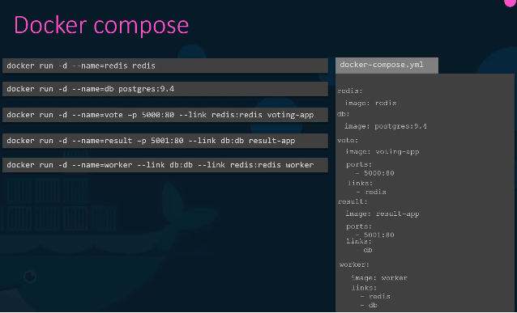
Docker Compose
Install Docker Compose
Create Compose File using Yaml
Run Docker compose

Slide 19
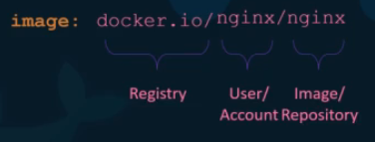
Docker Registry
A Docker registry is a storage and distribution system for named Docker images. The same image might have multiple different versions, identified by their tags. A Docker registry is organized into Docker repositories , where a repository holds all the versions of a specific image.
Exercise: Try to push the docker image to docker hub. With out user account tag it will not push image.
Docker Naming Convention

Slide 20
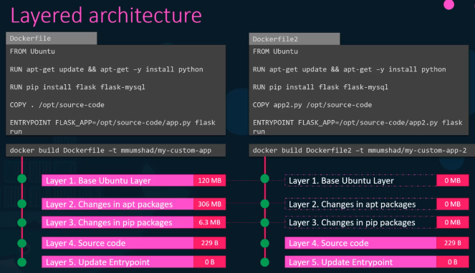

Slide 21
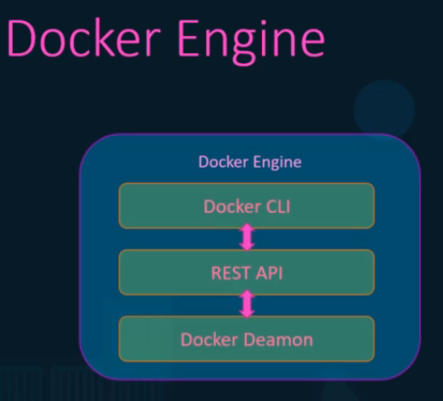
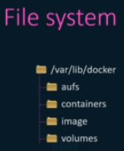
Docker Engine, Storage and Networking
Namespaces are used to isolate the process ids in host with container.
Docker Storage and File System
Docker CLI can be run from another host.
Docker -H=10.123.115.11:2375 run nginx
cgroups can be used to manage docker host resources
$docker run --cpus=.5 ubuntu
$docker run --memory=100m ubuntu

Slide 22
Image Layer vs Container Layer
Image layer is read-only
Container Layer on read-write
Volumes
In Docker, a "volume" is a mechanism to share and persist data between containers and the host system.
Example of using a named volume in a Docker run command:
$docker run -v my_volume:/path/in/container my_image
In this example, a named volume called "my_volume" is created, and the container at "/path/in/container" has access to this volume.
$docker run -v data_volume:var/lib/mysql mysql
Example of using a bind mount:
$docker run -v /host/path:/path/in/container my_image
In this case, the "/host/path" directory on the host machine is mounted to "/path/in/container" in the container.
$docker run -v /data/mysql:/var/lib/mysql

Slide 23
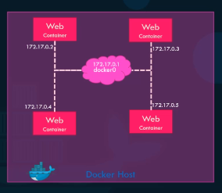
$docker network ls
$docker network create \
--driver-bridge \
--subnet 192.168.1.1 \
Custom-isolated-network
$docker inspect <container name> to find the docker network
Docker Networking
When docker is installed, it will create 3 networks automatically.
Bridge – Private internal network created by Docker and it is the default
None – Is an isolated network that do not attached to anything
Host – It is the Host network.
To access the containers in Bridge Network, map the ports on container to Host network
None cannot be connected to Outside world
In Host network, we can associate the docker container directly to the Host network. But we cannot create the same multiple containers because the port is already bound to container.
Containers communicate using their names using internal DNS.

Slide 24
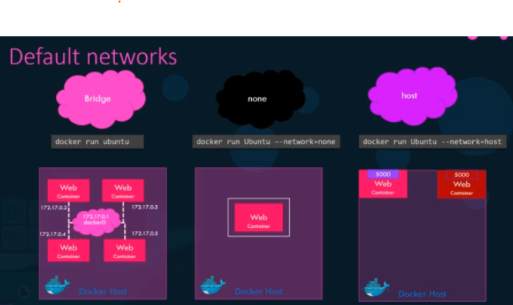

Slide 25
Why Orchestration?
Orchestration allows us to manage and maintain multiple containers. Having deferent configurations and environments become easier with Orchestration.
Benefits of Orchestration
Easy Management and Deployment
Health Monitoring
Load Balancing
Scaling and Roll Back
Security
Docker Swarm
Docker Swarm is an orchestration service within Docker that allows us to manage and handle multiple containers at the same time. It is also a cluster of containers.

Slide 26
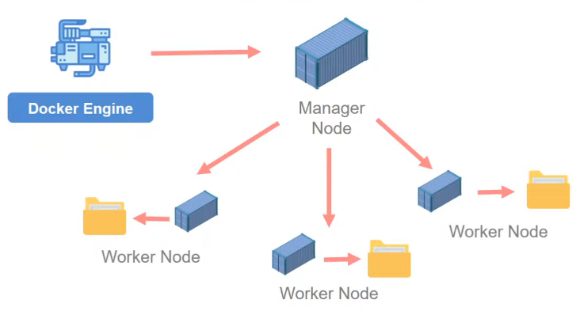
Docker Swarm Architecture

Slide 27
Docker Swarm Components
Swarm Manager: The Swarm Manager is responsible for controlling the entire Swarm and orchestrating the deployment of services.
There can be multiple managers in a Swarm for high availability and fault tolerance.
Managers maintain the cluster state, schedule services, and orchestrate node updates.
Worker Nodes: A worker node is a node that runs the application in a cluster and reports to a control plane. The main responsibilities of a worker node is to process data stored in the cluster and handle networking to ensure traffic between the application across the cluster and outside of the cluster
Services: A service defines the tasks to be executed on the worker nodes and the configuration for each task, such as the number of replicas.
Services enable you to scale applications horizontally by deploying multiple replicas across the Swarm.
Tasks: A task represents the basic unit of work in a Swarm, typically corresponding to a running container. Tasks are scheduled by the Swarm Manager based on the desired state of the service.

Slide 28
Docker Swarm in Action
Initializing and configuring Swarm
$docker swarm init
$docker info
Docker Swarm Service
In Swarm, containers are launched using services. A service is a group of containers of the same image that enables the scaling of applications.
Docker Swarm Stack
Docker Stack sits at a higher level than Docker containers and helps to manage the orchestration of multiple containers across several machines.
Service vs Stack
Service is the Swarm equivalent of a container. It represents one single container, running on one or more machines. Stack is the Swarm equivalent of Docker Compose. It represents several services, linked up to each other and deployed using a single configuration

